Slide 1
Security Evaluation

Slide 2
What is Formal Evaluation?
Method to achieve Trust
  Not a guarantee of security
Evaluation methodology includes:
  Security requirements
  Assurance requirements showing how to establish security requirements met
  Procedures to demonstrate system meets requirements
  Metrics for results (level of trust)
Examples: TCSEC (Orange Book), ITSEC, CC

Slide 3
Formal Evaluation: Why?
Organizations require assurance
  Defense
  Telephone / Utilities
  “Mission Critical” systems
Formal verification of entire systems not feasible
Instead, organizations develop formal evaluation methodologies
  Products passing evaluation are trusted
  Required to do business with the organization

Slide 4
Rainbow Series—Early 1980’s
ORANGE BOOK, ETC.

Slide 5
TCSEC
Trusted Computer System Evaluation Criteria
("Orange Book")
Standard for single computer systems with terminal access
First standard definition of a trusted computer system, how to evaluate and ensure them
Original spec Aug 83, revised Dec 85
Has tight coupling between functionality & assurance

Slide 6
TCSEC
Trusted Computer System Evaluation Criteria
("Orange Book")
provides users with a yardstick with which to assess the degree of trust that can be placed in computer systems for the secure processing of classified or other sensitive information
provides guidance to manufacturers as to what to build into their new, widely-available trusted commercial products in order to satisfy trust requirements for sensitive applications
And provides a basis for specifying security requirements in acquisition specifications.

Slide 7
TCSEC
Trusted Computer System Evaluation Criteria
("Orange Book")
Two types of requirements are delineated for secure processing
  specific security feature requirements
  assurance requirements.

Slide 8
Criteria
Six fundamental requirements are derived from this basic statement of objective
  four deal with what needs to be provided to control access to information
  and two deal with how one can obtain credible assurances that this is accomplished in a trusted computer system.

Slide 9
Criteria
Requirement 1
SECURITY POLICY
  There must be an explicit and well-defined security policy enforced by the system.
  Given identified subjects and objects, there must be a set of rules that are used by the system to determine whether a given subject can be permitted to gain access to a specific object.

Slide 10
Criteria
Requirement 2
MARKING
  Access control labels must be associated with objects.
  In order to control access to information stored in a computer, according to the rules of a mandatory security policy, it must be possible to mark every object with a label that reliably identifies the object‘s sensitivity level (e.g., classification), and/or the modes of access accorded those subjects who may potentially access the object.

Slide 11
Criteria
Requirement 3
IDENTIFICATION
  Individual subjects must be identified.
  Each access to information must be mediated based on who is accessing the information and what classes of information they are authorized to deal with.
  This identification and authorization information must be securely maintained by the computer system and be associated with every active element that performs some security-relevant action in the system.

Slide 12
Criteria
Requirement 4
ACCOUNTABILITY
  Audit information must be selectively kept and protected so that actions affecting security can be traced to the responsible party.
  A trusted system must be able to record the occurrences of security-relevant events in an audit log.
  The capability to select the audit events to be recorded is necessary to minimize the expense of auditing and to allow efficient analysis.
  Audit data must be protected from modification and unauthorized destruction to permit detection and after-the-fact investigations of security violations.

Slide 13
Criteria
Requirement 5
ASSURANCE
  The computer system must contain hardware/software mechanisms that can be independently evaluated to provide sufficient assurance that the system enforces requirements 1 through 4 above.
  In order to assure that the four requirements of Security Policy, Marking, Identification, and Accountability are enforced by a computer system, there must be some identified and unified collection of hardware and software controls that perform those functions.

Slide 14
Criteria
Requirement 6
CONTINUOUS PROTECTION
  The trusted mechanisms that enforce these basic requirements must be continuously protected against tampering and/or unauthorized changes.
  No computer system can be considered truly secure if the basic hardware and software mechanisms that enforce the security policy are themselves subject to unauthorized modification or subversion.

Slide 15
Other "Rainbow Book" Standards
Red Book
    Trusted Network Interpretation
Yellow Book
    Methodology for Security Risk Assessment
Lavender Book
    Database Security Evaluation

Slide 16
Evaluation Criteria Classes
Class | Description
D | Minimal Protection
C1 | Discretionary Security Protection
C2 | Controlled Access Protection
B1 | Labelled Security Protection
B2 | Structured Protection
B3 | Security Domains
A1 | Verified Design

Slide 17
Evaluation Classes A and B
A1 Verified protection; significant use of formal methods; trusted distribution; code, FTLS correspondence
B3 Security domains; full reference validation mechanism; increases trusted path requirements, constrains code development; more DTLS requirements; documentation
B2 Structured protection; formal security policy model; MAC for all objects, labeling; trusted path; least privilege; covert channel analysis, configuration management
B1 Labeled security protection; informal security policy model; MAC for some objects; labeling; more stringent security testing

Slide 18
Evaluation Classes C and D
C2 Controlled access protection; object reuse, auditing, more stringent security testing
C1 Discretionary protection; minimal functional, assurance requirements; I&A controls; DAC
D Did not meet requirements of any other class

Slide 19
How is Evaluation Done?
Government-sponsored independent evaluators
  Application phase:
    Determine if government cares
  Preliminary Technical Review phase
    Discussion of process, schedules
    Development Process
    Technical Content, Requirements
  Evaluation Phase

Slide 20
TCSEC: Evaluation Phases
Three phases
  Design analysis
    Review of design based on documentation
  Test analysis
  Final Review
Trained independent evaluation
  Results presented to Technical Review Board
  Must approve before next phase starts
Ratings Maintenance Program
  Determines when updates trigger new evaluation

Slide 21
TCSEC: Problems
Based heavily on confidentiality
  Did not address integrity, availability
Tied security and functionality
Base TCSEC geared to operating systems
  TNI(87): Trusted Network Interpretation
  TDI(92): Trusted Database management System Interpretation

Slide 22
Contributions
Heightened awareness in commercial sector to computer security needs
Commercial firms could not use it for their products
  Did not cover networks, applications
  Led to wave of new approaches to evaluation
  Some commercial firms began offering certifications
Basis for several other schemes, such as Federal Criteria, Common Criteria

Slide 23
Later Standards
CTCPEC (89) – Canada
ITSEC(91) – European Standard
  Levels correspond to strength of evaluation (E1—E6, E0)
  Includes code evaluation, development methodology requirements
  Introduced Target of Evaluation (TOE), Security target
CISR: Commercial International Security Req (91)
  Commercial outgrowth of TCSEC
Federal Criteria(92): TCSEC Modernization (NIS+NSA)
  Introduced protection profile (PP)
  PP: abstract specification of the security aspects of an IT product
FIPS 140: Cryptographic module validation
Common Criteria: International Standard
SSE-CMM: Evaluates developer, not product
Notes:
CMM levels: Informally, planned and tracked, well-defined, quantitatively controlled, continuous improvement

Slide 24
ITSEC
Information Technology Security Evaluation Criteria (ITSEC)
European trusted evaluation standard harmonized with TCSEC
  - Unlike TCSEC, designed for both single & multiple networked systems
  - Target Of Evaluation (TOE) = evaluated system
  - Structured around - assurance and functionality
Details evaluation process by independent evaluators working with developer and sponsor
Evaluator:
    - Checks test & analysis results supplied by sponsor and
    - Performs additional tests to audit and supplement these

Slide 25
Assurance
Correctness is addressed both from:
    - development process & environment in building TOE
    - operation of the TOE
TOE must also be assessed for:
- suitability and binding of functionality
    - consequences of known and discovered vulnerabilities
    - strength of security mechanisms against direct attack

Slide 26
Assurance –
7 evaluation levels
E0 - inadequate
E1 - statement of security objects, informal description of security architecture
E2 - +informal description of detailed design, testing, configuration control
and controlled distribution
E3 - +detailed design and source code evaluated
E4 - +formal security policy model, rigorous architectural and detailed design,
vulnerability analysis
E5 - +close correspondence between detailed design and source code,
vulnerability analysis on source code
E6 - +formal description of TOE consistent with formal security model,
evaluation of object code against source

Slide 27
Functionality
Expressed as security objectives, functions & mechanisms
Security objectives defined as natural language security policy or formal model
Functionality classes defined by categories:
        identification & authentication,
        access control,
        accountability,
        audit,
        object reuse,
        accuracy,
        reliability of service and
        data exchange

Slide 28
Functionality Levels
F1-F5 - map onto TCSEC classes with appropriate assurance levels
(C1,C2,B1,B2,B3,A1 = F1+E1,F2+E2,F3+E3,F4+E4,F5+E5,F5+E6)
F6 - high integrity systems (eg. financial)
F7 - high availability/mission critical systems
F8 - high integrity data communications systems
F9 - high confidentiality data communications systems
F10 - high confidentiality and integrity networks

Slide 29
ITSEC Problems:
No validation that security requirements made sense
  Product meets goals
  But does this meet user expectations?
Inconsistency in evaluations
  Not as formally defined as TCSEC

Slide 30
FIPS 140: 1994–Present
Evaluation standard for cryptographic modules (implementing cryptographic logic or processes)
  Established by US government agencies and Canadian Security Establishment
Updated in 2001 to address changes in process and technology
  Officially, FIPS 140-2
Evaluates only crypto modules
  If software, processor executing it also included, as is operating system

Slide 31
Requirements
Four increasing levels of security
FIPS 140-1 covers basic design, documentation, roles, cryptographic key management, testing, physical security (from electromagnetic interference), etc.
FIPS 140-2 covers specification, ports & interfaces; finite state model; physical security; mitigation of other attacks; etc.

Slide 32
Security Level 1
Encryption algorithm must be FIPS-approved algorithm
Software, firmware components may be executed on general-purpose system using unevaluated OS
No physical security beyond use of production-grade equipment required

Slide 33
Security Level 2
More physical security
  Tamper-proof coatings or seals or pick-resistent locks
Role-based authentication
  Module must authenticate that operator is authorized to assume specific role and perform specific services
Software, firmware components may be executed on multiuser system with OS evaluated at EAL2 or better under Common Criteria
  Must use one of specified set of protection profiles

Slide 34
Security Level 3
Enhanced physical security
  Enough to prevent intruders from accessing critical security parameters within module
Identity-based authentication
Stronger requirements for reading, altering critical security parameters
Software, firmware components require OS to have EAL3 evaluation, trusted path, informal security policy model
  Can use equivalent evaluated trusted OS instead

Slide 35
Security Level 4
“Envelope of protection” around module that detects, responds to all unauthorized attempts at physical access
  Includes protection against environmental conditions or fluctuations outside module’s range of voltage, temperatures
Software, firmware components require OS meet functional requirements for Security Level 3, and assurance requirements for EAL4
  Equivalent trusted operating system may be used

Slide 36
Impact
By 2002, 164 modules, 332 algorithms tested
  About 50% of modules had security flaws
  More than 95% of modules had documentation errors
  About 25% of algorithms had security flaws
  More than 65% had documentation errors
Program greatly improved quality, security of cryptographic modules

Slide 37
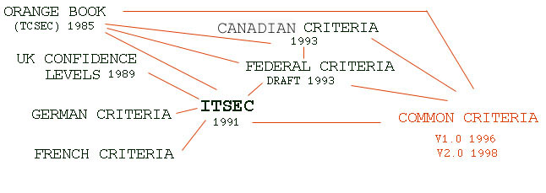

Common Criteria: 98- Present
Origin

Slide 38
98 - Present
Replaced TCSEC, ITSEC, CTCPEC, FC
CC had three parts
  CC Documents
    Functional requirements
    Assurance requirements
    Evaluation Assurance Levels (EAL)
  CC Evaluation Methodology (CEM)
    Detailed evaluation guidelines for each EAL
  National Scheme (Country specific)

Slide 39
Evaluation Methodology
CC documents
  Overview of methodology, functional requirements, assurance requirements
CC Evaluation Methodology (CEM)
  Detailed guidelines for evaluation at each EAL; currently only EAL1–EAL4 defined
Evaluation Scheme or National Scheme
  Country-specific infrastructures implementing CEM
  In US, it’s CC Evaluation and Validation Scheme; NIST accredits commercial labs to do evaluations

Slide 40
CC Terms
Target of Evaluation (TOE): system or product being evaluated
TOE Security Policy (TSP): set of rules regulating how assets managed, protected, distributed within TOE
TOE Security Functions (TSF): set consisting of all hardware, software, firmware of TOE that must be relied on for correct enforcement of TSP
  Generalization of TCB

Slide 41
Protection Profiles
CC Protection Profile (PP): implementation-independent set of security requirements for category of products or systems meeting specific consumer needs
  Includes functional requirements
    Chosen from CC functional requirements by PP author
  Includes assurance requirements
    Chosen from CC assurance requirements; may be EAL plus others
  PPs for firewalls, desktop systems, etc.
  Evolved from ideas in earlier criteria

Slide 42
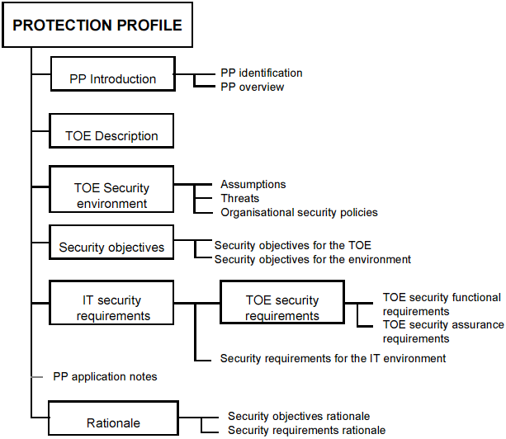
Protection Profile

Slide 43
Form of PP
Introduction
  PP Identification and PP Overview
Product or System Family Description
  Includes description of type, general features of product or system
Product or System Family Security Environment
  Assumptions about intended use, environment of use;
  Threats to the assets; and
  Organizational security policies for product or system

Slide 44
Form of PP (con’t)
Security Objectives
  Trace security objectives for product back to aspects of identified threats and/or policies
  Trace security objectives for environment back to threats not completely countered by product or systemand/or policies or assumptions not completely met by product or system
IT Security Requirements
  Security functional requirements drawn from CC
  Security assurance requirements based on an EAL
    May supply other requirements without reference to CC

Slide 45
Form of PP (con’t)
Rationale
  Security Objectives Rationale demonstrates stated objectives traceable to all assumptions, threats, policies
  Security Requirements Rationale demonstrates requirements for product or system and for environment traceable to objectives and meet them
  This section provides assurance evidence that PP is complete, consistent, technically sound

Slide 46
Security Target
CC Security Target (ST):
  set of security requirements and specifications to be used as basis for evaluation of identified product or system
  Can be derived from a PP, or directly from CC
    If from PP, ST can reference PP directly
  Addresses issues for specific product or system
    PP addresses issues for a family of potential products or systems

Slide 47
How It Works
Find appropriate PP and develop appropriate ST based upon it
  If no PP, use CC to develop ST directly
Evaluate ST in accordance with assurance class ASE
  Validates that ST is complete, consistent, technically sound
Evaluate product or system against ST

Slide 48
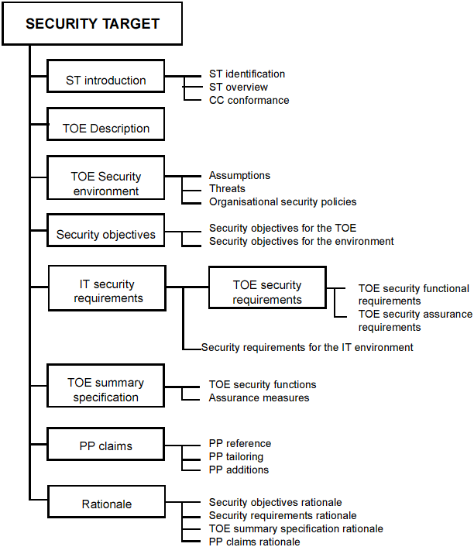
Security Target

Slide 49
Form of ST
Introduction
  ST Identification, ST Overview
  CC Conformance Claim
Product or System Description
  Describes TOE as aid to understanding its security requirement
Product or System Family Security Environment
Security Objectives
IT Security Requirements
  These are the same as for a PP

Slide 50
Form of ST (con’t)
Product or System Summary Specification
  Statement of security functions, description of how these meet functional requirements
  Statement of assurance measures specifying how assurance requirements met
PP Claims
  Claims of conformance to (one or more) PP requirements

Slide 51
Form of ST (con’t)
Rationale
  Security objectives rationale demonstrates stated objectives traceable to assumptions, threats, policies
  Security requirements rationale demonstrates requirements for TOE and environment traceable to objectives and meets them
  TOE summary specification rationale demonstrates how TOE security functions and assurance measures meet security requirements
  Rationale for not meeting all dependencies
  PP claims rationale explains differences between the ST objectives and requirements and those of any PP to which conformance is claimed

Slide 52
CC Requirements
Both functional and assurance requirements
EALs built from assurance requirements
Requirements divided into classes based on common purpose
Classes broken into smaller groups (families)
Families composed of components, or sets of definitions of detailed requirements, dependent requirements and definition of hierarchy of requirements

Slide 53
Common Criteria(362 page):
Functional Requirements
11 Classes (Functional requirements)
  Security Audit (6), Communication (2), Cryptography (2), User data protection (13), ID/authentication (6), Security Management (6), Privacy, Protection of Security Functions (16), Resource Utilization (3), Access (6), Trusted paths (2)
Several families per class
Lattice of components in a family

Slide 54
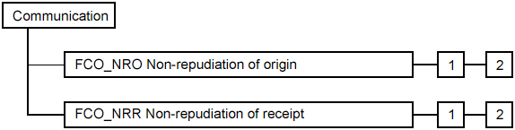
Class Example:
Communication
Non-repudiation of origin
  Selective Proof. Capability to request verification of origin
  Enforced Proof. All communication includes verifiable origin

Slide 55
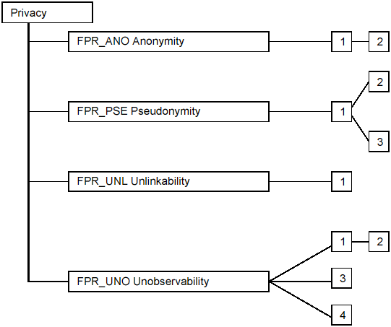
Class Example:Privacy
Pseudonymity
  The TSF shall ensure that [assignment: set of users and/or subjects] are unable to determine the real user name bound to [assignment: list of subjects and/or operations and/or objects]
  The TSF shall be able to provide [assignment: number of aliases] aliases of the real user name to [assignment: list of subjects]
  The TSF shall [selection: determine an alias for a user, accept the alias from the user] and verify that it conforms to the [assignment: alias metric]
Reversible Pseudonimity
  …
Alias Pseudonimity
  …

Slide 56
Common Criteria:(216 page)
Assurance Requirements
10 Classes
  Protection Profile Evaluation (6), Security Target Evaluation (8), Configuration management (3), Delivery and operation (2), Development (7), Guidance Documentation (2), Life cycle (4), Tests 4), Vulnerability assessment (4), Maintenance of assurance (4)
Several families per class
Lattice of components in family

Slide 57
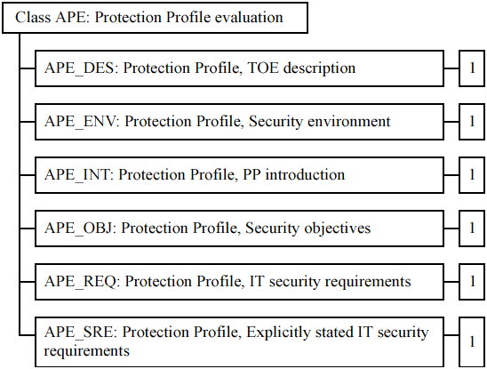
Example:
Protection Profile Evaluation
Security environment
In order to determine whether the IT security requirements in the PP are sufficient, it is important that the security problem to be solved is clearly understood by all parties to the evaluation.
Protection Profile, Security environment, Evaluation requirements
  Dependencies: No dependencies.
  Developer action elements:
The PP developer shall provide a statement of TOE security environment as part of the PP.
  Content and presentation of evidence elements:
….

Slide 58
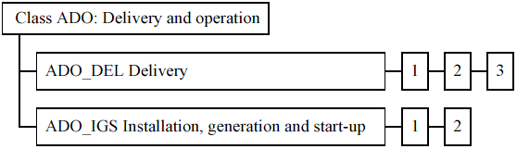
Example:
Delivery and Operation
Installation, generation and start-up
Installation, generation, and start-up procedures
  Dependencies: AGD_ADM.1 Administrator guidance
Developer action elements:
  The developer shall document procedures necessary for the secure installation, generation, and start-up of the TOE.
Content and presentation of evidence elements:
  The documentation shall describe the steps necessary for secure installation, generation, and start-up of the TOE.
…..

Slide 59
Common Criteria: Evaluation Assurance Levels (EAL)
Functionally tested
Structurally tested
Methodically tested and checked
Methodically designed, tested, and reviewed
Semi-formally designed and tested
Semi-formally verified design and tested
Formally verified design and tested

Slide 60
Common Criteria:
Evaluation Process
National Authority authorizes evaluators
  U.S.: NIST accredits commercial organizations
  Fee charged for evaluation
Team of four to six evaluators
  Develop work plan and clear with NIST
  Evaluate Protection Profile first
  If successful, can evaluate Security Target

Slide 61

Common Criteria:
Status
About 80 registered products
  Only one at level 5
  (Java Smart Card)
  Several OS at 4
  Likely many more not registered
New versions appearing on regular basis

Slide 62
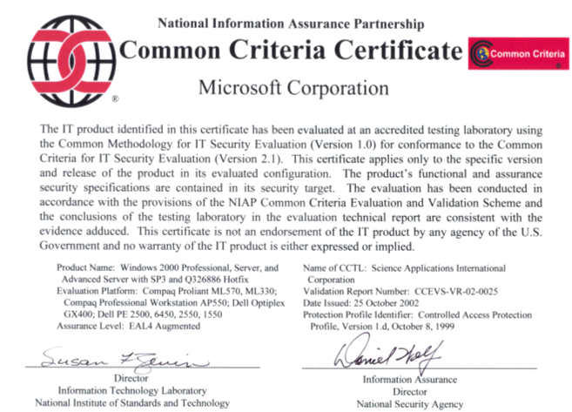

Slide 63


